Slide 1
2. Similar Triangles
…are triangles having the same shape but different size.
71°
These are all similar triangles as they are all the same shape, even though some are rotated or flipped.
71°
20°
71°
20°
20°
71°
71°
Note that the 3 angles of each are the same.
20°
20°

Slide 2
Similar Triangles
Can be overlayed one on top of the other – so it’s easy to see corresponding angles are equal

Slide 3
If 2 triangles are similar, then their matching pairs of sides are in ratio
c
a
d
b
e
f
Provided they’re similar, that is, the angles of one are equal to angles of the other

Slide 4

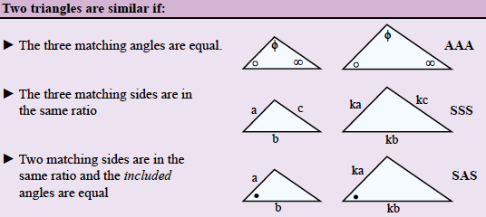
24
7
30
Similar Triangles
Date
EQ – What are the characteristics of similar triangles and how do we determine similarity?
What are similar shapes?
5

Slide 5
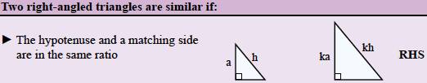

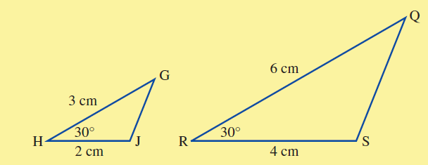
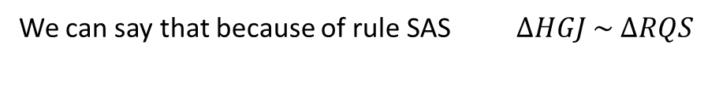
24
7
30
Similar Triangles
Date
EQ – What are the characteristics of similar triangles and how do we determine similarity?
B
A
C
What are similar shapes?
If we know 2 triangles are similar we write a statement of similarity.
Example
Since these 2 triangles have 2 sets of sides with the same ratio and the angle between is the same.
We can say that because of rule SAS $∆HGJ \sim ∆RQS$
5

Slide 6
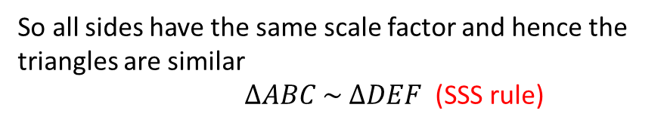
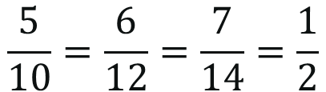
Why are these triangles Similar?
B
E
(1)
5
7
10
14
A
6
C
D
F
12
Can only be SSS rule as no angles involved.
$$\frac{5}{10}=\frac{6}{12}=\frac{7}{14}=\frac{1}{2}$$
So all sides have the same scale factor and hence the triangles are similar
$∆ABC \sim ∆DEF$ (SSS rule)

Slide 7
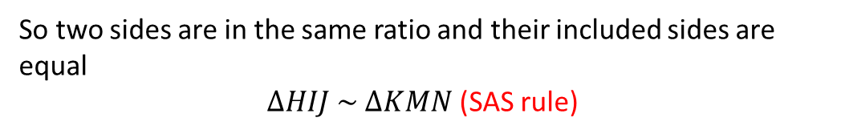
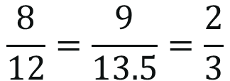
Why are these triangles Similar?
I
M
(2)
8
12
51°
H
9
J
51°
K
N
13.5
Can only be SAS rule as only one angle involved.
$$\frac{8}{12}=\frac{9}{13.5}=\frac{2}{3}$$
And their included angles are both 51°
So two sides are in the same ratio and their included sides are equal
$∆HIJ \sim ∆KMN$ (SAS rule)

Slide 8

Why are these triangles Similar?
T
Z
(3)
63°
51°
66°
51°
S
R
66°
63°
X
Y
Can only be AA rule as angles only are involved.
The missing angle from Triangle 1 is 180 – 114 = 66°
The missing angle from Triangle 2 is 180 – 117 = 63°
So all angles are equal
$∆STR \sim ∆XZY$ (AA rule)

Slide 9

Why are these triangles Similar?
D
A
3cm
x cm
9cm
5cm
B
30°
C
30°
F
E
y cm
They have 2 matching angles $∠B=∠$E and $∠$C =$∠$F
so $∆STR \sim ∆XZY$ (AA)

Slide 10
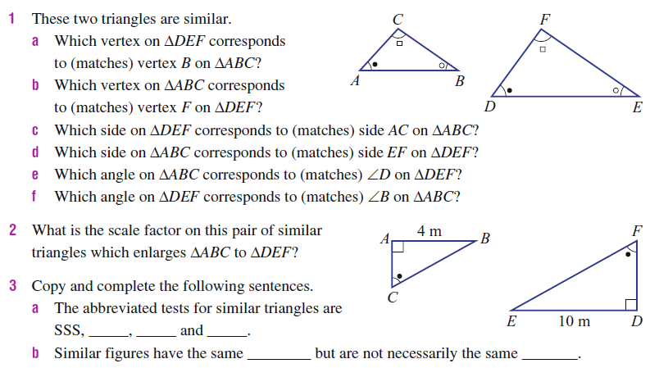
Task
Essential Mathematics Exercise 7G - Page 426

Slide 11
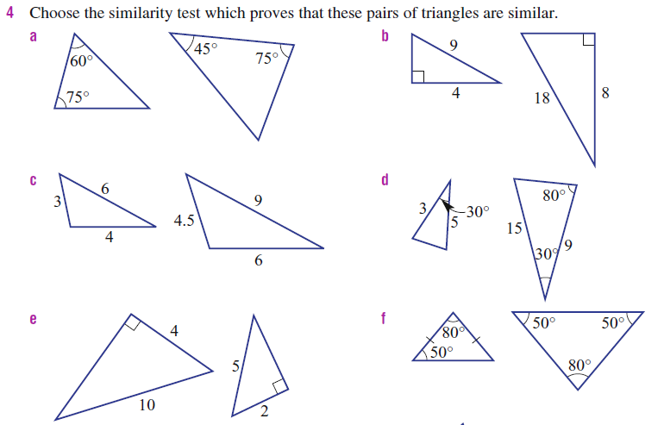
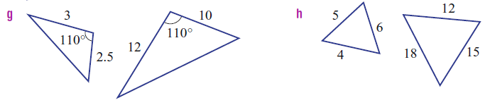

Slide 12
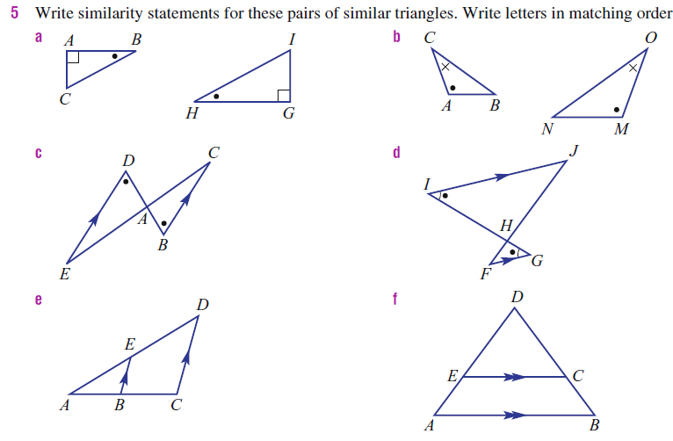

Slide 13
Notes Review
24, 7 ,30
Date
Title
Essential question
Notes complete
Notes complete with colour and diagrams
Questions completed
Contents page filled in
Formula page filled in

Slide 14
Homework
Review your notes and write a summary answering the essential question.

